Slide 1
FIN 9002: Empirical Methods in Corporate Finance
Professor Lalitha Naveen
Fox School of Business

Slide 2
Reading
Start by skimming Introduction
A good Intro will quickly highlight:
Main research question
Importance/relevance of this question
How do the authors approach this question – i.e., what is the experiment?
Main findings
Incremental contribution of this paper

Slide 3
Reading
Next glance through the tables
What is your interpretation of the results?
Now read – what is authors’ interpretation?
Are authors interpreting results correctly?
If not, why not?
This could be a potential research topic for you

Slide 4
Reading
Next glance through the tables
What is your interpretation of the results?
Now read – what is authors’ interpretation?
Are authors interpreting results correctly?
Do the authors tests help address their main research questions?
Read the conclusions – do you agree with authors’ conclusions?

Slide 5
Lets try this out….
Download Voting Rationales (by Michaely et al., 2026) from Canvas
Spend 15-20 minutes summarizing the paper
Each group to try to answer questions on slide 1
Main research question
Importance/relevance of this question
How do the authors approach this question – i.e., what is the experiment?
Main findings
Incremental contribution of this paper

Slide 6
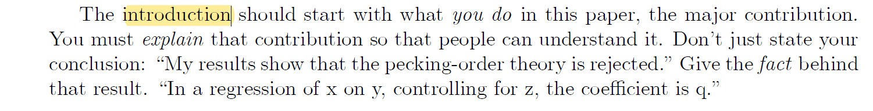
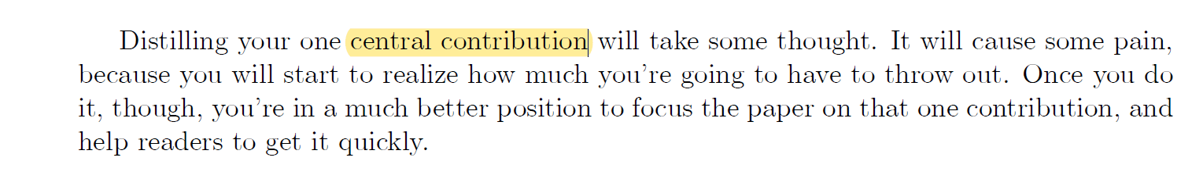
Cochrane on writing well…

Slide 7
Writing: The research statement
What does the paper do?
Explain as concisely and clearly as possibly

Slide 8
Writing: The research statement
“The purpose of our research is to examine whether and how customer satisfaction ratings are potentially influenced by gender and racial bias……. Hekman et al., AMJ, 2010
“In this article, we study incumbent stores' reactions to a Wal-Mart entry into their local markets and the consequences of these reactions for the stores' sales outcomes. The specific objectives are (1) to quantify how incumbents change their pricing, promotion, and product assortment in reaction to the entry and how their sales are affected by the entry; (2) to examine how these reactions and sales outcomes vary across retail formats, stores, and product categories; and (3) to investigate whether and how incumbents' reactions influence their sales outcomes” Ailawadi et al., JMR, 2010

Slide 9
Writing: The research statement
“In this paper, we synthesize information for 97 characteristics shown to predict cross‐sectional stock returns in peer‐reviewed finance, accounting, and economics journals. Our goal is to better understand what happens to return predictability outside a study's sample period. …..Mclean and Pontiff, JF, 2015

Slide 10
Writing: The research statement
“The question we address is whether application of International Accounting Standards (IAS) is associated with higher accounting quality than application of non‐U.S. domestic standards. In particular, we investigate whether accounting amounts of firms that apply IAS exhibit less earnings management, more timely loss recognition, and higher value relevance than accounting amounts of firms that apply domestic standards.…” Barth et al., 2008

Slide 11
Writing: The Contribution
What is the contribution (i.e., “what am I learning?”)?
CONTRIBUTION IS WHAT CAUSES PAPER TO BE PUBLISHED
CONTRIBUTION IS WHAT LEADS TO IMPACT

Slide 12
Writing: The Contribution
“The purpose of our research is to examine whether and how customer satisfaction ratings are potentially influenced by gender and racial bias…….
Finding empirical evidence of racial or gender biases in customer satisfaction would suggest that organizations have a financial incentive to favor white or male employees. Such a finding may help explain the persistent inequality between demographic groups in the workplace.”
“In this article, we study incumbent stores' reactions to a Wal-Mart entry into their local markets and the consequences of these reactions for the stores' sales outcomes. The specific objectives are (1) to quantify how incumbents change their pricing, promotion, and product assortment in reaction to the entry and how their sales are affected by the entry; (2) to examine how these reactions and sales outcomes vary across retail formats, stores, and product categories; and (3) to investigate whether and how incumbents' reactions influence their sales outcomes.
……This paper makes several contributions to the literature on response to large store entry. First,…..”

Slide 13
Writing: The Contribution
“In this paper, we synthesize information for 97 characteristics shown to predict cross‐sectional stock returns in peer‐reviewed finance, accounting, and economics journals. Our goal is to better understand what happens to return predictability outside a study's sample period.
……our results suggest that academic publications transmit information to sophisticated investors”

Slide 14
Writing: The Contribution
“The question we address is whether application of International Accounting Standards (IAS) is associated with higher accounting quality than application of non‐U.S. domestic standards.1 In particular, we investigate whether accounting amounts of firms that apply IAS exhibit less earnings management, more timely loss recognition, and higher value relevance than accounting amounts of firms that apply domestic standards.
……We contribute to the literature examining the quality of IAS‐based accounting amounts in two ways. First,…”

Slide 15
Writing: the CONTRIBUTIOn
Contribution is something that significantly advances our understanding of how the world works
My JFE (2006)
◻ Before: People unsure whether options made managers increase risk.
◻ After: Vega from options causes increased risk-taking.
▪ My JFE (2008)
◻ Before: People thought that large boards hurt firms.
◻ After: Large boards are not always bad; they are beneficial for complex firms.

Slide 16
Writing: the CONTRIBUTIOn
Contribution is something that significantly advances our understanding of how the world works
▪ My RFS (2014)
◻ Before: Independent directors were good monitors.
◻ After: Not all independent directors are good monitors - Those that are co-opted are not.
▪ My RFS (2020)
◻ Before: Pay for luck exists and it is consistent with rent extraction by CEOs.
◻ After: Pay for luck does not exist.

Slide 17
Writing: the INNOVATIOn
Innovation could come from a new or different:
Research Question (JAE, 2008)
Hypotheses (JFE, 2008)
Research Design (JFE, 2006)
Findings (RFS, 2019, Guthrie et al., JF 2012)

Slide 18
Writing: General
General
Active tense
Present tense

Slide 19
Writing: INTRODUCTIOn
Introduction
What you do
Why we should care
Elaborate on data used, methodology (if unique), main results
Place this in context of literature

Slide 20
Writing: Related literature
Literature Review
Only relevant literature
How does your paper fit in?
New data?
New model?
New identification strategy?
Papers more directly from your field
Papers from reasonable journals

Slide 21
Writing: DATA
Data Section
Data sources/names
Time period
Limitations (survey response rate, small # of obs, missing obs, survivorship bias etc.)

Slide 22
Writing: Results
Results
Only main results – not every result ever tried
No table that does not fit in with main research question
2 decimal places usually suffice: Don't report 1.23456789
Captions should be self-contained

Slide 23
Doing research
Getting ideas: Read latest research
Important online outlets for research
ssrn.com, nber.org, top journals in your field
Key academic conferences in your discipline
westernfinance.org, American Economic Association, SFS cavalcade, etc.
Favorite researchers in your area
Alex Edmans
Kelly Shue
Read business outlets
WSJ, Bloomberg,CNBC

Slide 24
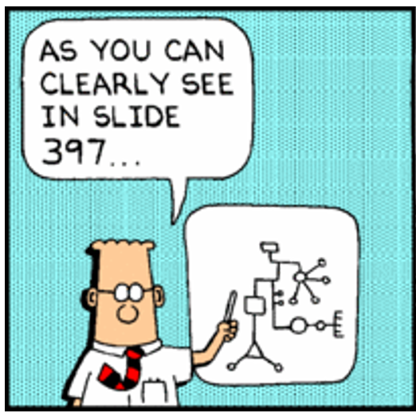
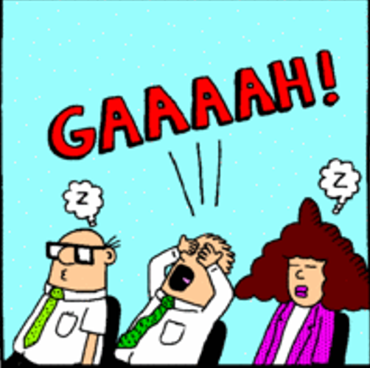
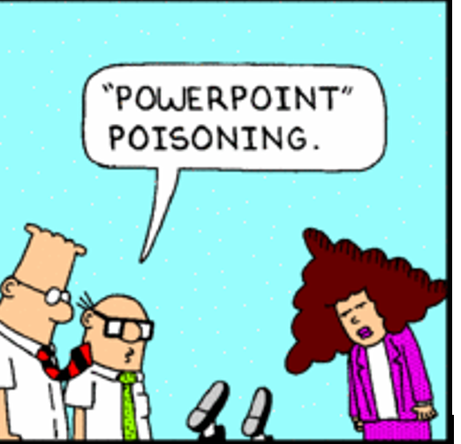
Presenting your research
Practice your presentation
Don’t read from the slide
Don’t put 10 lines into 1 slide
Don’t write down every word
Use extra slides

Slide 25
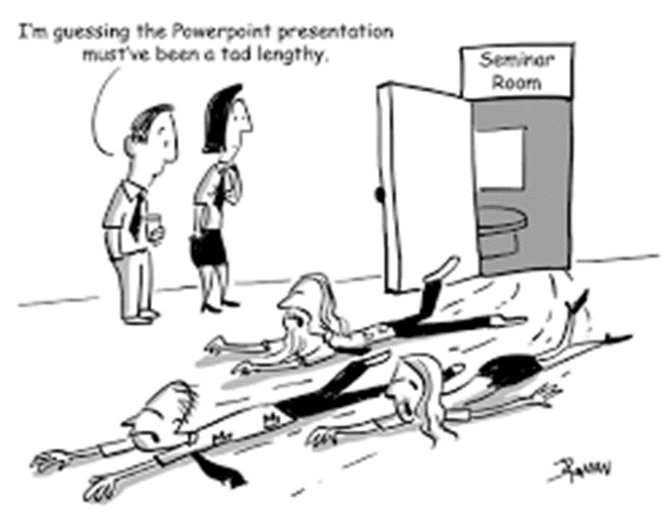
Presenting your research
Don’t need every variable you used in every regression
Don’t use “preview of results”
Don’t get defensive

Slide 26
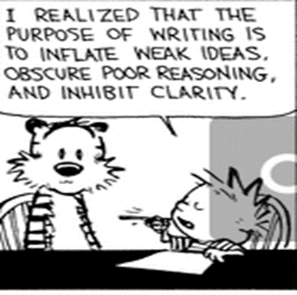
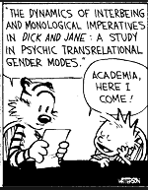
Presenting your Research
Start with contribution
Here is what I do..
Say why this is different..
Say why (anyone) should care..
Be concise

Slide 27
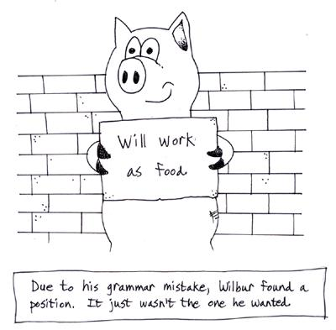
Presenting your research
Things that annoy a reader
Typos – proof read
Bad English – use copy editor if needed
Claiming more than you can
If you put so little effort into your writing, why should referee put effort into reading…?

